Slide 1
Biometric Recognition Lab Fingerprint Recognition
Kevin Hernández Díaz

Slide 2
Fingerprint Recognition: Fingerprint Patterns
Fingerprints are composed of different patterns
Parallel Lines
Core points
Delta points
Minutia points

Slide 3
Fingerprint Recognition: Fingerprint Patterns
Fingerprints are composed of different patterns
Parallel Lines: Most common pattern in the fingerprint
Core points
Delta points
Minutia points

Slide 4
Fingerprint Recognition: Fingerprint Patterns
Fingerprints are composed of different patterns
Parallel Lines
Core points: 1-2 per fingerprint. ~180 direction change of the ridges in a local area
Delta points
Minutia points

Slide 5
Fingerprint Recognition: Fingerprint Patterns
Fingerprints are composed of different patterns
Parallel Lines
Core points
Delta points: 1-2 per fingerprint. Triangular shape pattern
Minutia points

Slide 6
Fingerprint Recognition: Fingerprint Patterns
Fingerprints are composed of different patterns
Parallel Lines
Core points
Delta points
Minutia points: Dozens per fingerprint. A point where a ridge ends or diverge in two/ two ridges converge in 1

Slide 7
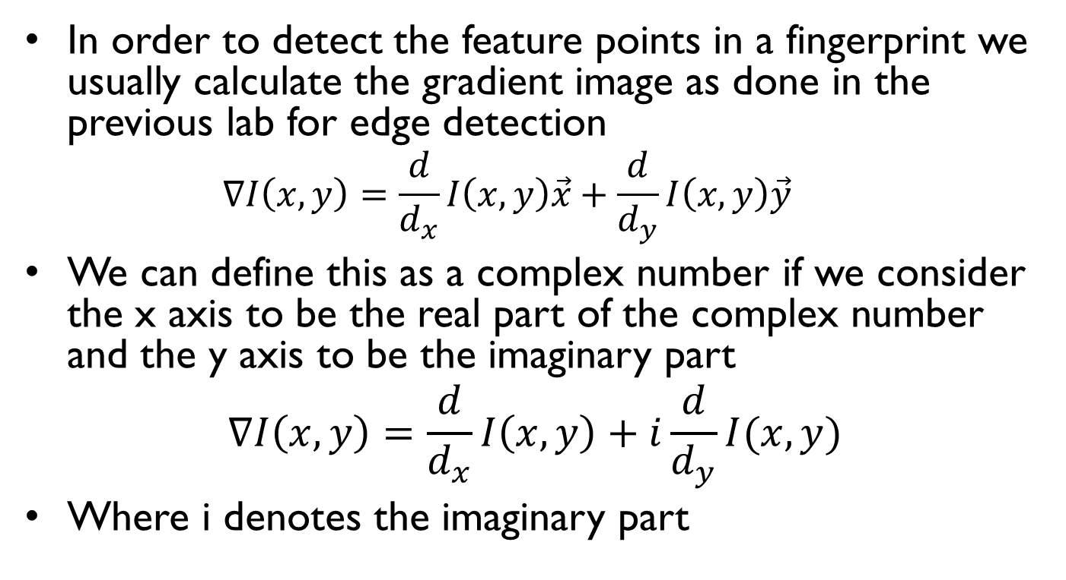
Fingerprint Recognition: brief reminder of complex numbers
In order to detect the feature points in a fingerprint we usually calculate the gradient image as done in the previous lab for edge detection
$$∇I\left(x,y\right)=\frac{d}{d_{x}}I\left(x,y\right)\vec{x}+\frac{d}{d_{y}}I\left(x,y\right)\vec{y}$$
We can define this as a complex number if we consider the x axis to be the real part of the complex number and the y axis to be the imaginary part
$$∇I\left(x,y\right)=\frac{d}{d_{x}}I\left(x,y\right)+i\frac{d}{d_{y}}I(x,y)$$
Where i denotes the imaginary part

Slide 8



Fingerprint Recognition: brief reminder of complex numbers
We can represent a complex number as a vector:
With x (real) and y (imaginary) coordinates
With magnitude $M$ and angle $φ$
Im
$$M$$
(x,y)
$$φ$$
Real

Slide 9



Fingerprint Recognition: brief reminder of complex numbers
We can represent the gradient image from the output of the derivative filter in each direction:
$$Gradient={Res}_{x}+i{Res}_{y}=Mcos\left(φ\right)+i Msin\left(φ\right)=Me^{iφ}$$
Euler identity
Im
Im
$$M$$
(Resx,Resy)
$$φ$$
Resy
Real
Resx
Real

Slide 10
Fingerprint Recognition: Detecting patterns in the image
From the gradient image we are interested in the “orientation map” which represents the local orientation at every pixel
We are not interested into exact pixel orientation but rather a local orientation
One problem arise, the gradient points into the direction of biggest change, so depending on which side of the ridge you stand, gradients points into opposite directions, which would make the local gradient=0!
valleys
ridges

Slide 11



Fingerprint Recognition: Detecting patterns in the image
Solution?
We multiply the angle at each pixel by 2!
$φ∗2=2φ$
$\left(φ+180°\right)∗2=2φ+360°=2φ$
$$e^{iφ}$$
$$e^{i2φ}$$
valleys
ridges
valleys
ridges

Slide 12
Fingerprint Recognition: Detecting patterns in the image
Detecting paraller lines:
Parallel line detector
Parallel line region
Gradient vectors
Core pattern region
Gradient vectors
filters
Patterns

Slide 13

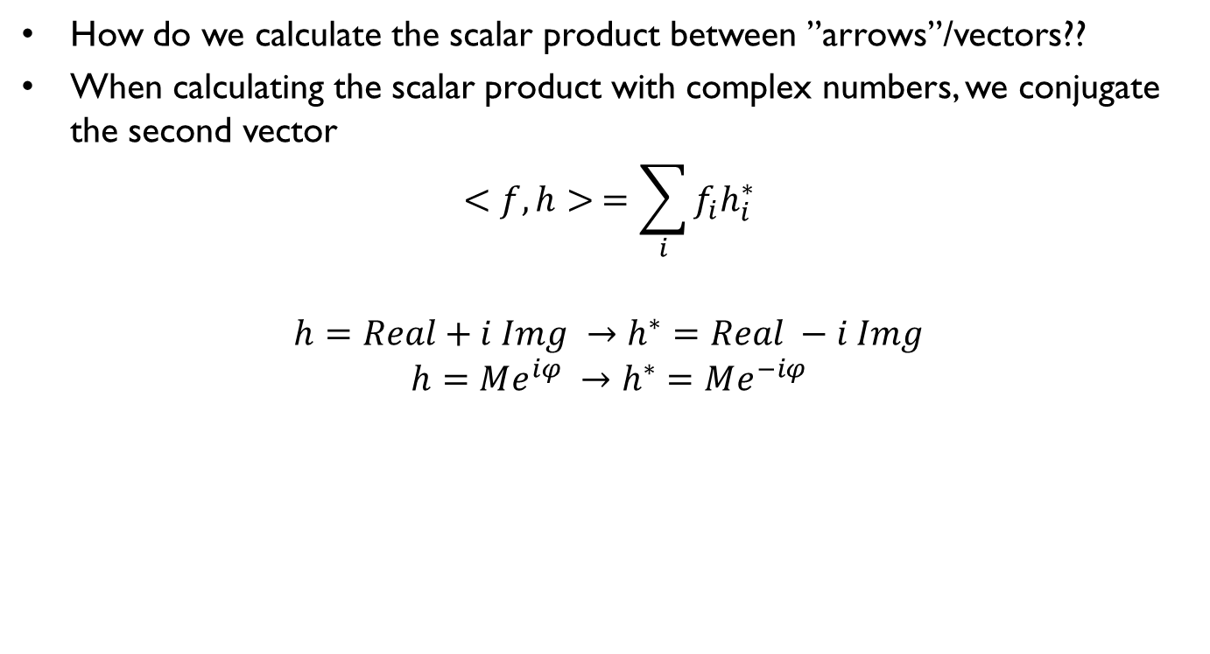
Fingerprint Recognition: Detecting patterns in the image
How do we calculate the scalar product between ”arrows”/vectors??
When calculating the scalar product with complex numbers, we conjugate the second vector
$$<f,h> =\sum_{i}{f_{i}h_{i}^{∗}}$$
$$h=Real+i Img →h^{∗}=Real −i Img$$
$$h=Me^{iφ} →h^{∗}=Me^{−iφ}$$
* Represents the conjugated
Img
Img
Img
Complex vector
Complex vector
=
Complex vector
*
$$e^{i90}∗e^{−i60}=e^{i30}$$
Real
Real
Real

Slide 14
Fingerprint Recognition: Detecting patterns in the image
Detecting paraller lines:
Long vector
Pointing at
1 direction
*
=
Parallel line region
filters
Null or small
vector
*
Core pattern region
filters

Slide 15
Fingerprint Recognition: Detecting patterns in the image
Detecting core patterns:
Core detector
Parallel line region
Gradient vectors
Core pattern region
Gradient vectors
filters
Patterns

Slide 16
Fingerprint Recognition: Detecting patterns in the image
Detecting paraller lines:
Null or small
vector
*
=
Core detector
Parallel line region
filters
Long vector
With 90 degrees
orientation
*
Core detector
Core pattern region
filters

Slide 17
Fingerprint Recognition: Detecting patterns in the image
Conclusions:
 | Parallel pattern | Core pattern
Filter for lines | Long vector with same direction as pattern | Zero or null vector
Filter for cores | Zero or null vector | Long vector with orientation of 90 degrees

Slide 18
Fingerprint Recognition: Detecting minutia points
Minutia points are located where a ridge ends or there is a bifurcation
Both can be detecting using the same filter since they have the same shape but oposite colors, so the gradients will be the same after the ”double” correction
Since minutia points ”look like” core-patterns we can use the same filter to detect them
Bifurcation
ending

Slide 19
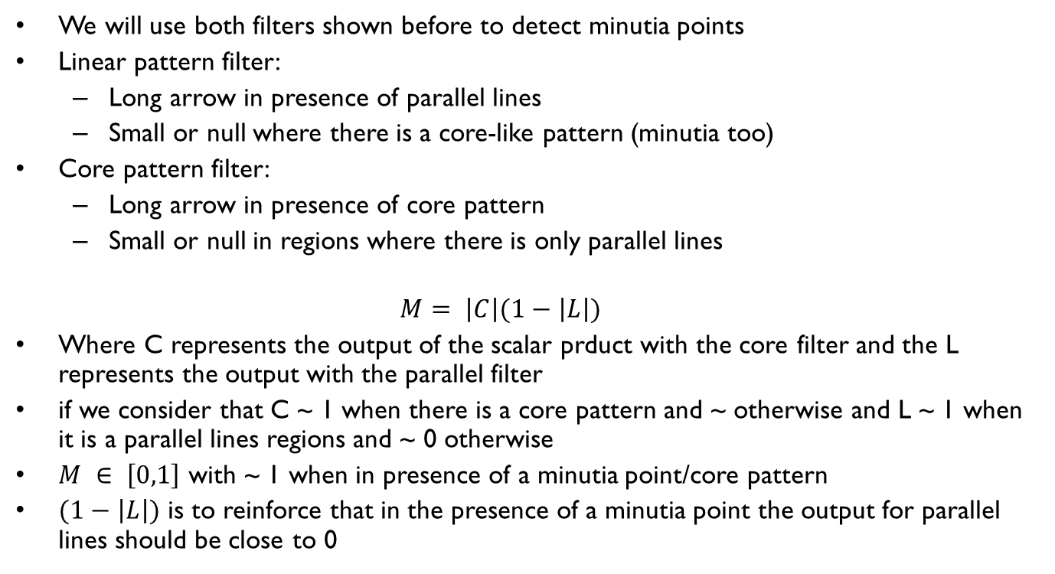
Fingerprint Recognition: Detecting minutia points
We will use both filters shown before to detect minutia points
Linear pattern filter:
Long arrow in presence of parallel lines
Small or null where there is a core-like pattern (minutia too)
Core pattern filter:
Long arrow in presence of core pattern
Small or null in regions where there is only parallel lines
$$M= \left|C\right|(1−\left|L\right|)$$
Where C represents the output of the scalar prduct with the core filter and the L represents the output with the parallel filter
if we consider that C ~ 1 when there is a core pattern and ~ otherwise and L ~ 1 when it is a parallel lines regions and ~ 0 otherwise
$M ∈ \left[0,1\right]$ with ~ 1 when in presence of a minutia point/core pattern
$(1−\left|L\right|)$ is to reinforce that in the presence of a minutia point the output for parallel lines should be close to 0

Slide 20
Fingerprint Recognition: Pyramid detection
We start from the full image at level 0, where all details are present.
We can only detect minutia points at this level, since they are fine details in the image
We low-pass filter the image to remove details and then reduce the size by half
In higher levels only global/macro details are present (cores and deltas) and they are easier to detect
Once detected in a upper levels we can update their position in lower levels. More accurate than trying to directly detect them at level 0
16x16
32x32
Level 4
Level 3
64x64
Level 2
128x128
Level 1
256x256
Level 0

Slide 21
Fingerprint Recognition: summary of detection procedure
Cores/delta points:
Core/delta points are available in all scales of the pyramid, thus find them in a higher level (e.g 3)
Then go down to the lower scales and refine the position of the detected core/delta by looking around the position from the previous scale. Go until level 0 (highest resolution)
Minutia points:
Minutia points are only available at lower scales, detect them at the highest resolution (scale 0)
Minutia points are difficult to detect anyways if quality of the fingerprint is bad
Then it may be necessary to enhance the image before the gradient is computed (will se in the lab exercise)

